Slide 1
Thought Leadership on E-Payment Gateways !!!
Session 35
Presenter : Brilliant Tleane

Slide 2
Challenges at Institutions
About e-Payment Gateways
Why e-Payment Gateways?
e-Payments we offer
Benefits
Security
Clients with e-Payments
Awareness Campaigns
Future for e-Payment Gateways

Slide 3
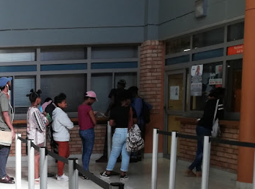
Challenges at Institutions
Student’s Safety
Institution’s Security
Queues on Campus
Increasing debt

Slide 4
About e-Payment Gateways

Slide 5
Why e-Payment Gateways?
Convenient Payment Platform
Cost-Effective
No cash or cheque handling fees
Pay anywhere at anytime
Accessibility
Security
Offers wide range of payment methods
No need to carry cash around :
they offer security to prevent fraud

Slide 6
Current e-Payment Gateways
Old MyGate
Local Payments
International Students

Slide 7
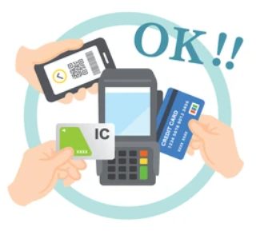
Benefits of e-Payment Gateways
Assist Institutions to reduce debt
Save cost on handling cash
Reduce payment turnaround time
Offers multiple payments methods

Slide 8
Security around e-Payment Gateways
3D Secure
Check-Sum
Protects against fraud, stolen card transaction and chargeback
Prevent data manipulation in transit
PCI DSS Compliant
Tokens/Keys
Global forum which set Security standards
Add more security to ensure that you are talking to the right system

Slide 9
Clients Success Stories

Slide 10
Awareness Campaigns

Slide 11
Awareness Campaigns
Announcements
Social Media Campaigns
Posters on Campus, Emails, SMS’s, Website
Leverage popular social media platforms
Campus Events
Partner with Student Organisations
Distribute promotional materials
Collaborate with Clubs, Student Organisations etc

Slide 12
The Future of e-Payment Gateways

Slide 13
The Future of e-Payment Gateways
Card-less Services
Digital Walltes
No more cards
Apple Pay, Google Pay etc
Contactless Payments
API’s
Seamlessly integration into workflows
QR Code, NFC (Near Field Communication)

Slide 14
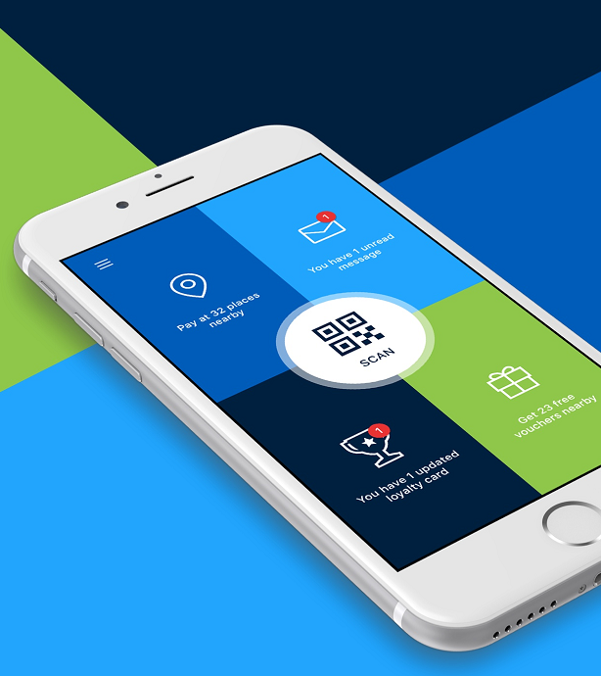
Zapper e-Payment Gateway
Mobile payment platform
Makes mobile payments via QR codes, barcodes, and links convenient and secure, instore and online
Changing the way you pay, making it faster, safer and more rewarding

Slide 15
Zapper e-Payment Gateway
No more cards (Card-less service)
Get paid anywhere
Easily split bills with friends, tip for service, earn loyalty, redeem vouchers, rate your service
User-friendly mobile app

Slide 16
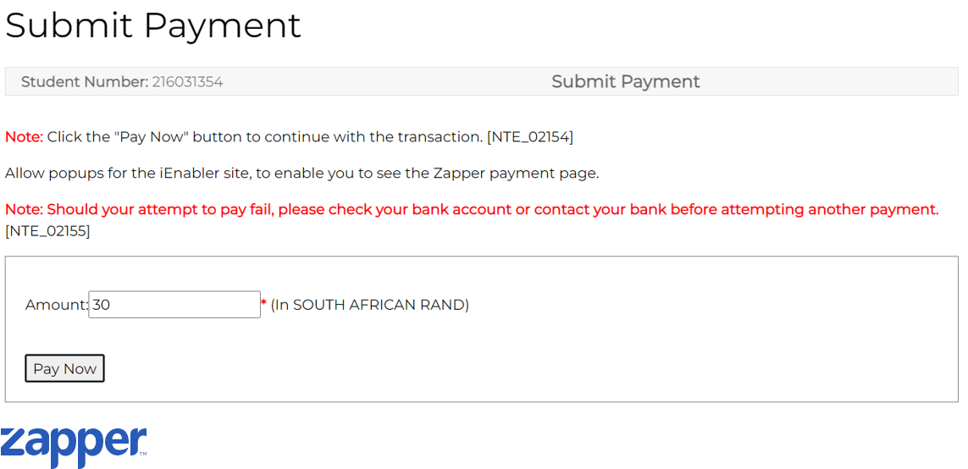
Zapper e-Payment Gateway

Slide 17
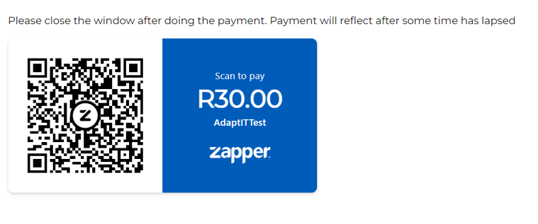
Zapper e-Payment Gateway

Slide 18
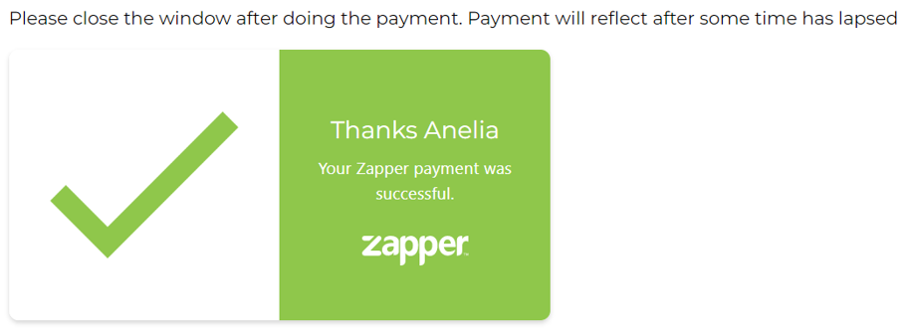
Zapper e-Payment Gateway

Slide 19
Zapper e-Payment Gateway

Slide 20
Conclusion
Let’s embrace innovation and empower growth in higher education through advanced technologies for efficiency and impact !!!

Slide 21
Questions?

